Slide 1
Basics of Big Data
Instructor: Mr. Ali Khelef
Assistant Lecturer - EASTC
Email: ali.khelef@eastc.ac.tz

Slide 2
Basics of Big Data
Learning Outcomes
Describe the concepts of Big Data
Describe the architecture of Big Data
Apply big data processing models to summarize and explore big data
Describe big data analytics techniques

Slide 3
Basics of Big Data
Brief Introduction(Questions)
What is Big Data
Mention some examples of Big Data
What are the main sources of Big Data
What are the characteristics of Big Data

Slide 4
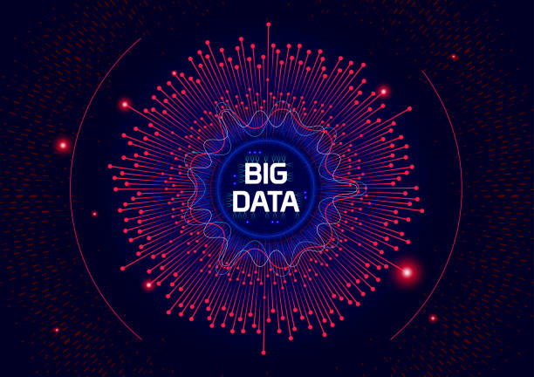
What is Big Data?
Big Data
Big data refers to any collection of data sets which are so large and/ or complex that becomes difficult to store, manage, and process using traditional data management ttechniques such as the RDBMS.
It is a kind of data that is generated at a very large scale with a very high speed which come from different formats. (It includes data such as video, audio, google searches, machine logs, tweets, facebook/Whatsapp charts, etc)
Big data needs modern computing technologies such as Hadoop, Cassandra, Google Analytics, etc to process and analyze in order to uncover useful information.
Big Data Computing
Big data computing deals with collection, storage, processing and analysis of massive-scale data on cloud-based computing systems

Slide 5
5Vs of Big Data
Characteristics of Big Data
Volume: Big data is a data whose volume is so large which requires specialized tools and frameworks to store, process and analyze such data.
Velocity: Big data are generated by different sources with very high velocities. To get useful insight specialized tools are required to ingest such high velocity data into big data infrastructure and analyze the data in a real-time.
Variety: Big data comes in different forms such as structured, unstructured or semi-structured, including text data, image, audio, video and sensor data. Big data systems need to be flexible enough to handle such variety of data.
Veracity: Big data can provide benefits if and only if the data is meaningful and accurate. It ensures that big data is accurate, complete, consistent, and reliable for decision-making. Thus, cleansing of data is important in big data so as to remove incorrect and faulty data.
Value: Value of data refers to the usefulness of data for the intended purpose. The end goal of any big data analytics system is to extract value from the data. (For example, Disease detection, Better treatment, Reduced cost, etc)

Slide 6
Challenges in Big Data
Activity: Group Work ( 20 minutes @ 10 marks)
Question: Discuss and explain the challenges and applications of Big Data

Slide 7
Challenges of Big Data
Big Data brings a lot of challenges that force the world to come up with powerful tools and technologies to solve the challenges. Some of the challenges are:
Lack of Data Storage due to large scale of data increases every second
Poor security due to poor data sharing mechanisms (cloud computing services, online purchases that leads to sharing of credit card details, etc
Lack of data schema: Big data has no data schema
Lack of data quality: Big data has poor/no data quality, it the job of data scientist to generate data quality with high accuracy in real-time manner.

Slide 8
Applications of Big Data
Big Data have many applications in different sectors: Some of them are:
Monitoring financial market activities. Banking and Securities Industry use network analytics and natural language processors to catch illegal trading activity in the financial markets.
Communications, Media and Entertainment Industries use big data to create content for different target audiences, recommend content on demand, and measure content performance.
Health sectors use Big data to provide personalized treatments as a way to combat with the cost of administering several medical/lab tests to all patients who go to the hospital.
Retail and Wholesales Industries use big data to optimize staffing, reduce fraud, and provide timely analysis of inventory

